Slide 1
0
0
0
1
2
3
4
5
6
7
8
9
10
0
0

Slide 2
Longest chain.
3
5
7
Block in the longest path.
Genesis block.
0
1
2
9
Block not in the longest path.

Slide 3





$$𝒰=\{ \}$$
6
8
3
5
7
0
1
2
9
$$PublishSet(\left\{6, 8\right\}, \{8→6,6→5\})$$
$$PublishSet(\left\{8\right\}, \{8→7\})$$
6
8
$$𝒰=\{ \}$$
$$𝒰=\{ \}$$
6
3
5
7
3
5
7
8
0
1
2
9
0
1
2
9

Slide 4






Attacker block.
$$B_{0}$$
0
$$B_{0,1}$$
0
1
Honest miner block.
0
0
1
Genesis block.
$$B_{1,0}$$
0
1
$$B_{x,0}$$
0
1
2
…
x
0
1
0
1
2
…
x
1
1
3
$$B_{1,x}$$
$$B_{2,1}^{HALF}$$
0
2
3
…
x+1
0
2
0
1
2
…
x
0
1
2

Slide 5
0
0

Slide 6
0
1
0
1

Slide 7
0
1
0
1

Slide 8
2
0
1
0
1
2

Slide 9
2
3
0
1
0
1
2
3

Slide 10
2
3
0
1
4
0
1
2
3

Slide 11
2
3
0
1
4
0
1
2
3

Slide 12
2
3
0
1
4
0
1
2
3

Slide 13
2
3
0
1
4
5
0
1
2
3
4

Slide 14
2
3
0
1
4
5
0
1
2
3
4

Slide 15
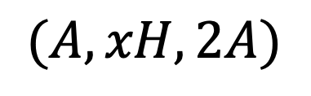
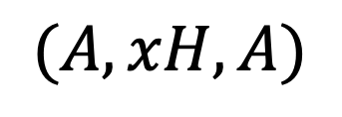
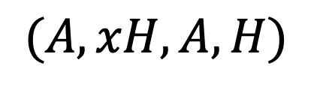
1
x+2
$$(A,xH,A)$$
0
2
3
…
x+1
0
1
2
…
x
x+1
1
x+2
x+3
$$(A,xH,2A)$$
0
2
3
…
x+1
0
1
2
…
x
x+1
x+2
1
x+2
$$(A,xH,A,H)$$
0
2
3
…
x+1
x+3
0
1
2
…
x
x+1

Slide 16

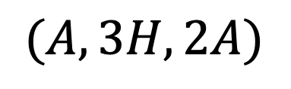
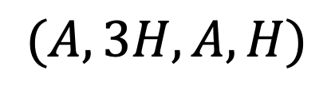
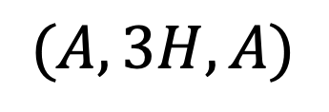
1
$$B_{1,3}$$
0
2
3
4
0
1
2
3
4
1
5
$$(A,3H,A)$$
0
2
3
4
0
1
2
3
4
1
5
6
$$(A,3H,2A)$$
0
2
3
4
0
1
2
3
4
5
1
5
$$(A,3H,A,H)$$
0
2
3
4
6
0
1
2
3
4
5

Slide 17
1
5
6
0
2
3
4
0
1
2
3
4
5
1
5
6
0
2
3
4
0
1
2
3
4
1
5
6
7
0
2
3
4
0
1
2
3
4
1
5
6
0
2
3
4
7
0
1
2
3
4
5

Slide 18
1
5
6
0
2
3
4
0
1
2
3
4
5
1
5
6
0
2
3
4
0
1
2
3
4
5
1
5
6
7
0
2
3
4
0
1
2
3
4
1
5
6
0
2
3
4
7
0
1
2
3
4
5

Slide 19
0
1
2
3
4
5
6
7
0
1
2
3
4
5
6
7
1
2
3
4
0
5
6
7
0
1
2
3
4

Slide 20
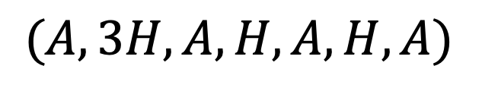
1
4
6
8
$$(A,3H,A,H,A,H,A)$$
0
2
3
5
7
0
1
2
3
4
5
1
4
6
8
1
4
6
8
0
2
3
5
7
0
2
3
5
7
0
1
2
3
4
5
0
1
2
3
4
5

Slide 21
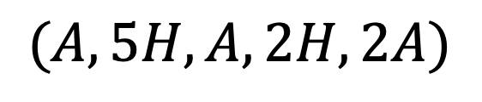
$$(A, 5H, A, 2H, 2A)$$
1
7
10
11
0
2
3
4
5
6
8
9
0
1
2
3
4
5
6
7
8
9

Slide 22






1
7
10
11
0
2
3
4
5
6
8
9
0
1
2
3
4
5
6
7
8
9
$${+\left(\frac{α}{1−α}\right)}^{4}$$
Vertical line at a height.
Heights between the current height and next height where there is a vertical line.
Part of the state which is covered up; blocks which are no longer considered.
1
7
10
11
0
2
3
4
5
6
8
9
0
1
2
3
4
5
6
7
8
9
$$+0$$
$$+0$$
$$+0$$
$$+0$$
1
7
10
11
0
2
3
4
5
6
8
9
0
1
2
3
4
5
6
7
8
9
$$+1$$
1
7
10
11
0
2
3
4
5
6
8
9
0
1
2
3
4
5
6
7
8
9
$$+0$$
1
7
10
11
0
2
3
4
5
6
8
9
0
1
2
3
4
5
6
7
8
9

Slide 23
1
6
7
8
0
2
3
4
5
9
0
1
2
3
4
5
6
7
1
6
7
0
2
3
4
5
0
1
2
3
4
5
6

Slide 24
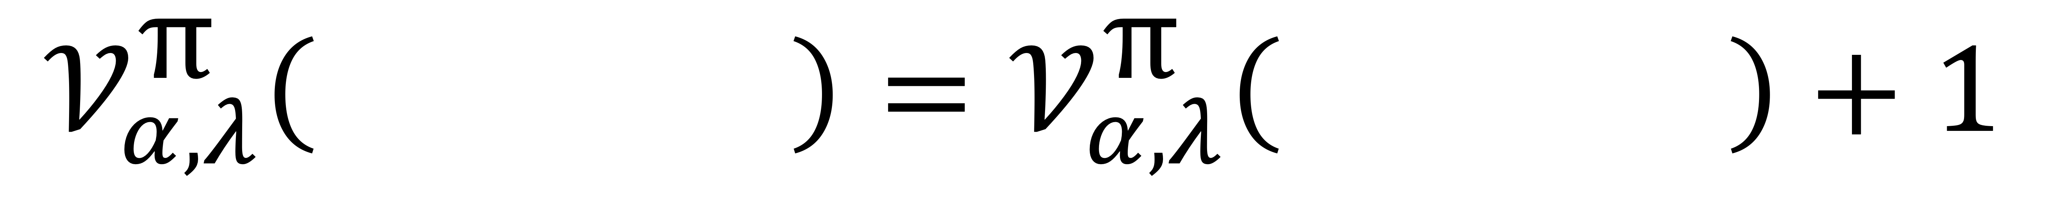
$$𝒱_{α,λ}^{\text{π}}\left( \right)=𝒱_{α,λ}^{\text{π}}\left( \right)+1$$
1
6
7
8
1
6
7
0
2
3
4
5
9
0
2
3
4
5
0
1
2
3
4
5
6
7
0
1
2
3
4
5
6

Slide 25
1
4
5
6
1
4
5
7
8
0
2
3
0
2
3
6
0
1
2
3
4
5
0
1
2
3
4
5
6
1
4
5
6
7
1
4
6
7
8
0
2
3
8
0
2
3
5
0
1
2
3
4
5
6
0
1
2
3
4
5
6
1
4
5
6
8
1
5
6
7
8
0
2
3
7
0
2
3
4
0
1
2
3
4
5
6
0
1
2
3
4
5
6
7

Slide 26
1
4
6
0
2
3
5
0
1
2
3
4
1
4
5
0
2
3
6
0
1
2
3
4

Slide 27
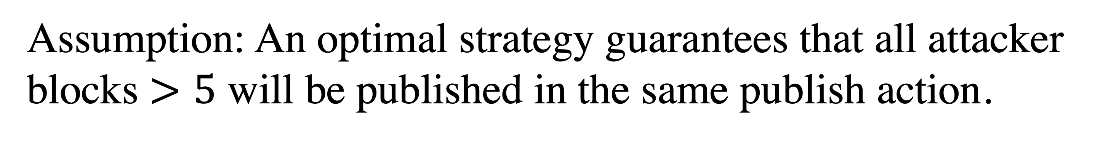
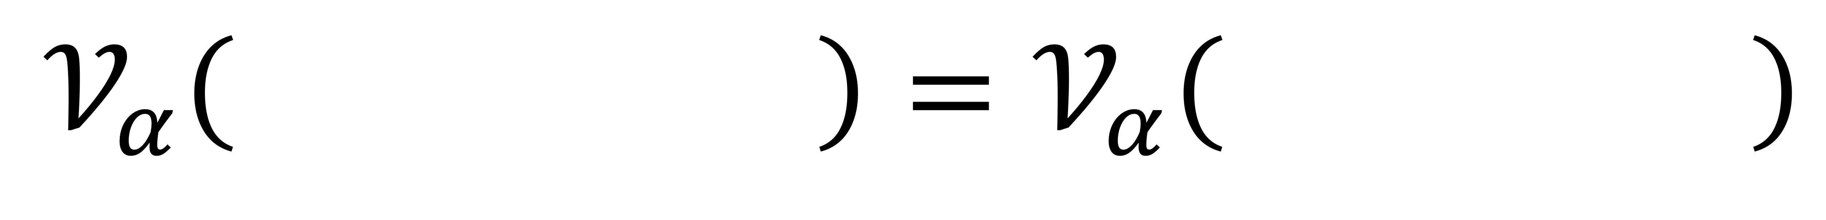
$$𝒱_{α}\left( \right)=𝒱_{α}\left( \right)$$
1
6
8
11
12
1
6
7
8
9
0
2
3
4
5
7
9
10
0
2
3
4
5
10
11
12
0
1
2
3
4
5
6
7
8
9
0
1
2
3
4
5
6
7
8
Assumption: An optimal strategy guarantees that all attacker blocks $>5$ will be published in the same publish action.

Slide 28
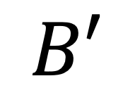
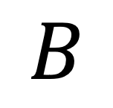

1
4
7
8
$$B$$
$$x=2≥\max{\{1,\left|T_{A}\left(B\right)\right|−2\}}$$
0
2
3
5
6
9
0
1
2
3
4
5
6
1
4
7
8
$$B′$$
0
2
3
5
6
9
10
11
0
1
2
3
4
5
6
7
$$\left\{b^{′}∈{ T}_{A}\left(B\right) | \left(b^{′}−1 ∉T_{A}\left(B\right)\right) ∧ (b^{′}−2∉T_{A}\left(B\right))\right\}=\{ \}$$
1
4
7

Slide 29
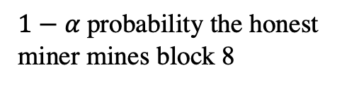
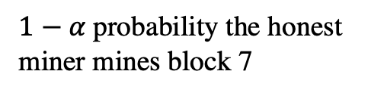
rob
1
5
6
1
5
6
1
5
6
7
0
2
3
4
0
2
3
4
7
0
2
3
4
0
1
2
3
4
5
0
1
2
3
4
5
0
1
2
3
4
5
6
$1−α$ probability the honest miner mines block 7
$1−α$ probability the honest miner mines block 8
1
5
6
1
5
6
7
0
2
3
4
7
8
0
2
3
4
8
0
1
2
3
4
5
6
0
1
2
3
4
5
6
at-risk block
timeserving action which publishes at-risk block
deficit visualization

Slide 30
1
4
7
8
9
(A, 2H, A, 2H, 3A)
0
2
3
5
6
0
1
2
3
4
5
6
7
1
5
8
9
0
2
3
4
6
7
(A, 3H, A, 2H, 2A)
0
1
2
3
4
5
6
7

Slide 31
1
4
9
10
11
0
2
3
5
6
7
8
0
1
2
3
4
5
6
7
8
9
(A,2H,A,4H,3A)

Slide 32
A, 2H, A, 2H, 2A
1
4
7
8
0
2
3
5
6
0
1
2
3
4
5
6
1
4
7
8
9
0
2
3
5
6
0
1
2
3
4
5
6
7

Slide 33
1
4
7
10
12
13
14
15
16
0
2
3
5
6
8
9
11
0
1
2
3
4
5
6
7
8
9
10
11
12

Slide 34
1
4
7
8
0
2
3
5
6
0
1
2
3
4
5
6
1
4
8
9
10
0
2
3
5
6
7
0
1
2
3
4
5
6
7
8

Slide 35
1
4
0
2
3
5
6
0
1
2
3
4

